Slide 1
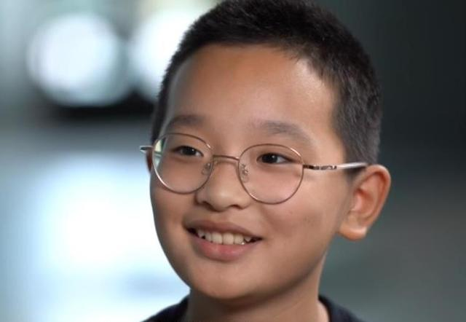
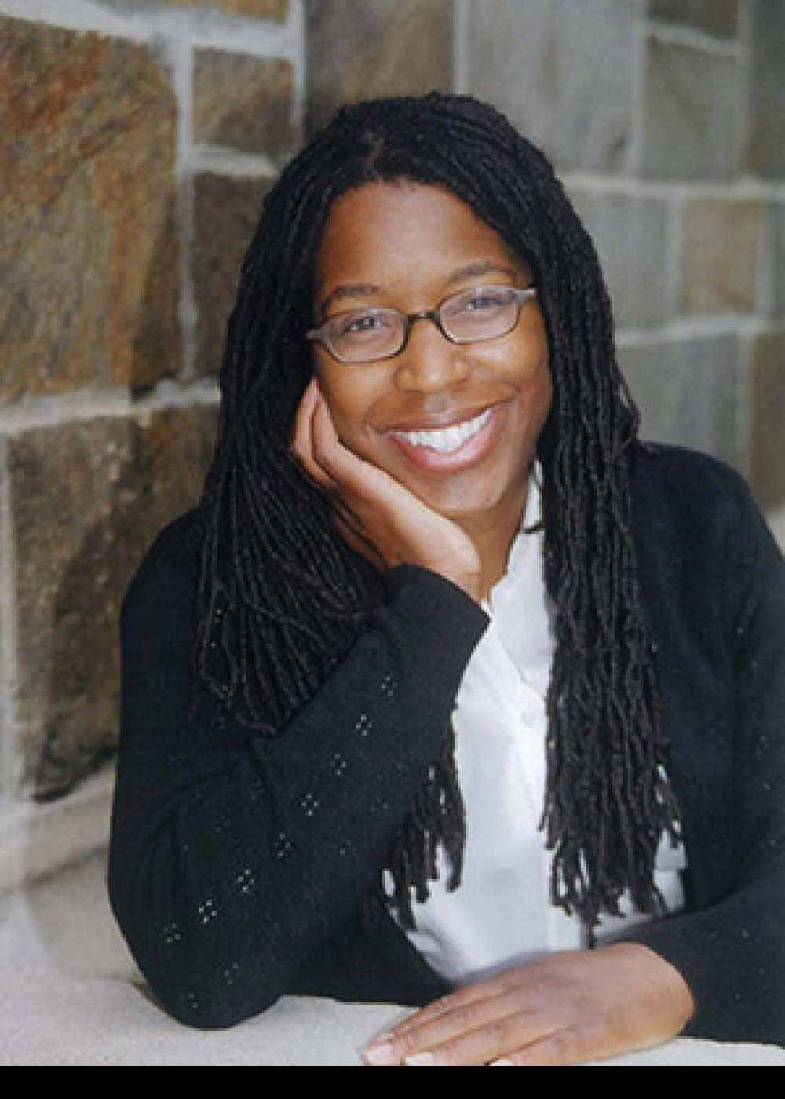

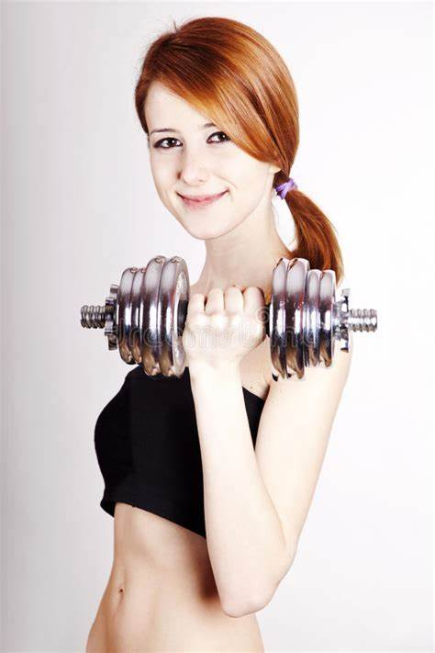
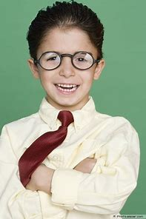
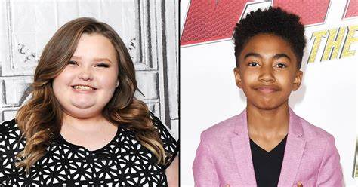
Unit 4
Looking good, feeling good
P1 Welcome to the unit

Slide 2

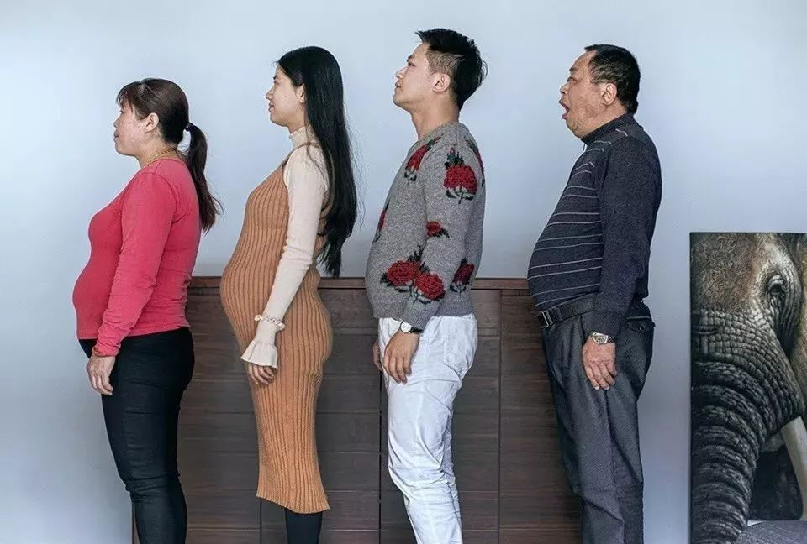
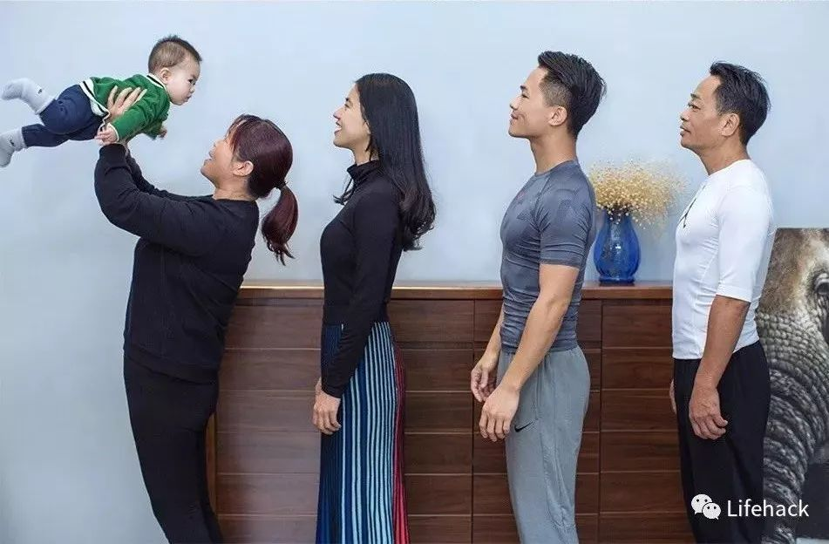
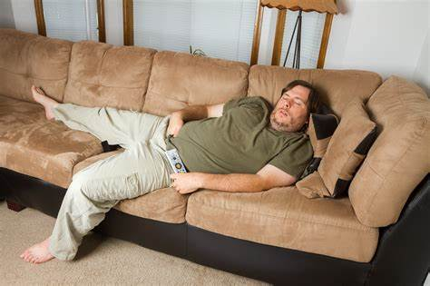
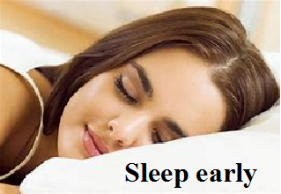
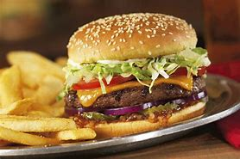
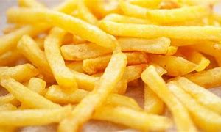
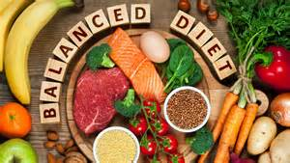
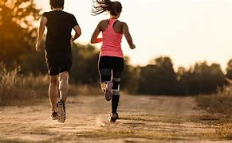
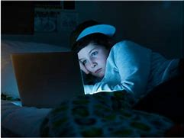
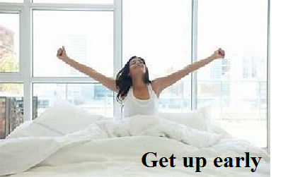
What do you think they did to change their
physical appearance?
Before
Different lifestyle
After
•Eat junk food
•Stay up late
•Hardly take exercise
•Eat healthy food
•Sleep and get up early
•Take regular exercise
Hardly take exercise
Eat healthy food
Eat junk food
Stay up late
Take regular exercise
Unhealthy lifestyle
Healthy lifestyle

Slide 3



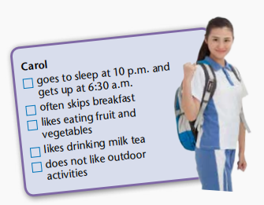
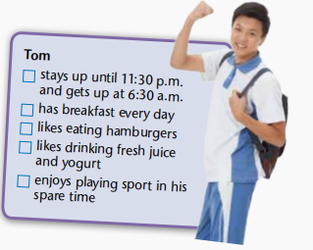


What good habits do Carol and Tom have? Tick the boxes above.
Carol and Tom are two senior high school students who have very different lifestyles. Read their lists of habits below and discuss the following questions in pairs.





How can Carol and Tom improve their lifestyles?

Slide 4
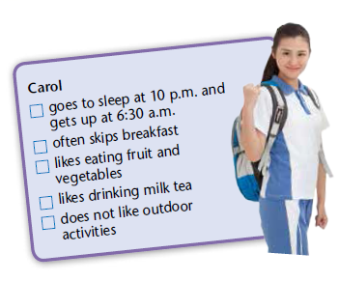

Group discussion
How can Carol improve her lifestyles?
For Carol:
eat breakfast every day
drink less milk tea
spend more time playing sports

Slide 5
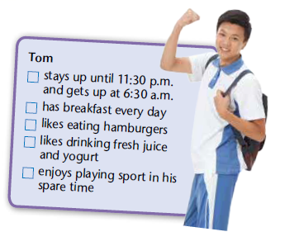
Group discussion
How can Tom improve his lifestyles?
For Tom:
go to sleep earlier
eat less junk food

Slide 6





What is your lifestyle like?
How can you improve it?
Eating habits
Sleeping habits
Exercise frequency
...
For example:
I go to sleep at 10 p.m. and get up early at 5:30 a.m. because I like running in the morning. I like eating hamburgers and drinking fresh juice for breakfast. I think I need to have healthier food for breakfast to improve my lifestyle.

Slide 7

What can we do to look good?
Does looking good mean feeling good? Which is more important, looking good or feeling good?
3. How can a person look good as well as feel
good?
Possible answers :
• Wear beautiful clothes;
• Keep a healthy lifestyle;
• Do plastic surgery;
• ...

Slide 8
We should try to keep physically and mentally
healthy to look good as well as feel good.
Physically healthy
1
Mentally healthy.
2
① Be confident.
① Do exercise regularly.
② Be free of depression.
② Have a healthy diet.
③ Be free of anxiety.
③ Develop a good sleeping habit.
④ Be free of other psychological issues.

Slide 9
Beauty is being the best possible version of yourself on the inside and out.
—Audrey Hepburn
美是从内到外做最好的自己。
——奥黛丽·赫本

Slide 10




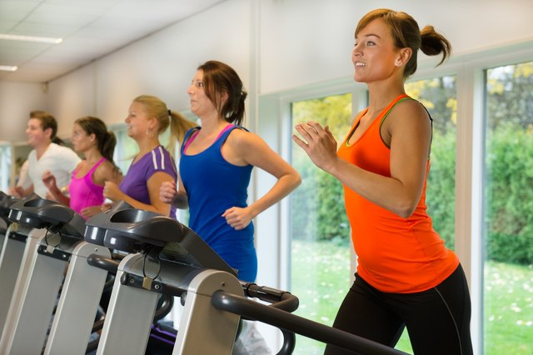
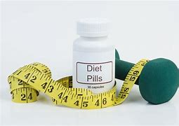
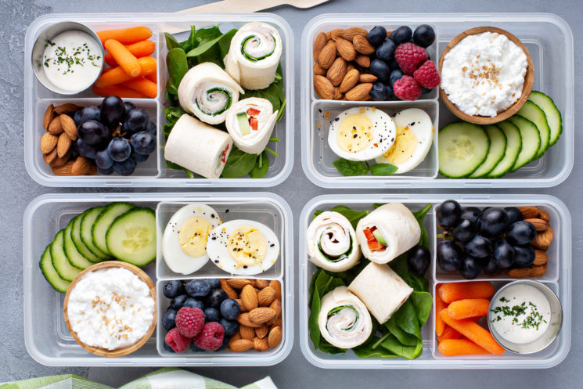
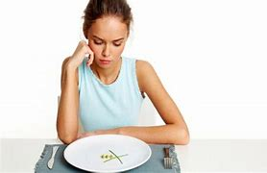
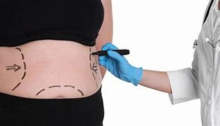
Do you know any ways to lose weight?
Suppose you are a person who is a little over-weight, how would you lose weight? Why?
Possible answers:
1. Take exercise.
2. Go on a diet.
Here is a news report about a teenage girl who tried to lose weight. Let's read the report and find out what happened.
3. Skip meals.
4. Take weight-loss pills.
5. Do plastic surgery.
...

Slide 11
Prediction
According to the title and the illustrations, what is covered in the news report?
A girl passed out because she did not eat breakfast regularly and was sent to an emergency ward（急诊病房） for treatment.

Slide 12

Watch the video and answer the following questions.
Q1
Why was Jennifer rushed to hospital?
Q2
What did Laura do when she found out
Jennifer was skipping meals?
Q3
What are some of the dangerous methods
teenagers use to lose weight?
Q4
What lifestyle tips did the expert give?

Slide 13
Check your answers.
Q1
Why was Jennifer rushed to hospital?
Because she passed out in her morning PE lesson after skipping meals.
Q2
What did Laura do when she found out
Jennifer was skipping meals?
She warned Jennifer that skipping meals was unhealthy, but she wouldn’t listen.

Slide 14
Q3
What are some of the dangerous methods
teenagers use to lose weight?
Skipping meals, over-exercising and taking weight-loss medicine.
Q4
What lifestyle tips did the expert give?
• Have a healthy balanced diet.
• Keep regular hours.
• Get plenty of exercise.

Slide 15

Read the news report again and complete the chart.
Para.1: A teenage girl fainted at school yesterday after skipping meals.
get slim
Paras._____: The girl skipped meals to ___________, She is now __________ in hospital.
2-4
recovering
5
Para.____:A survey shows that many teenagers are using __________ methods to lose weight.
extreme
6-7
Paras._________:The expert gives advice on how to ________________ properly.
lose weight

Slide 16
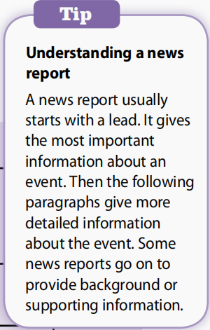
Understanding a news report
Para. 1: A teenage girl fainted
at school yesterday after
skipping meals.
Part 1 The lead
The most important information
Part 2
More detailed information
about the event
2-4
The girl skipped meals to get slim, She is now recovering in hospital.
Paras. :
5
Para. :
A survey shows that many teenagers are using extreme methods to lose weight.
Part 3
Background or
supporting information
Paras. :
6-7
The expert gives advice on how to lose weight properly.

Slide 17

Let’s learn more
What are the basic elements of a news report?

Slide 18
Headline
It sums up the report and catches the reader's attention.
A
Lead
It provides essential information including who, what, when, where, why and how.
B
Body
It contains additional information that helps
readers understand detailed information such as background and supporting information.
C
Tail
Inverted pyramid
It focuses on the least important information that is interesting or nice for readers.
D

Slide 19
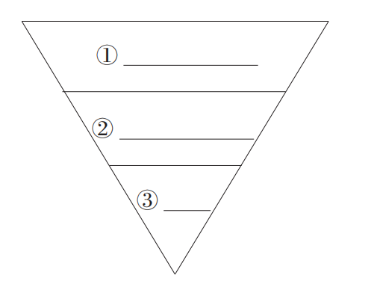
The inverted pyramid (倒金字塔)
It is a structure to illustrate how information should be
organized and arranged in a text.
Lead
Body
Tail

Slide 20
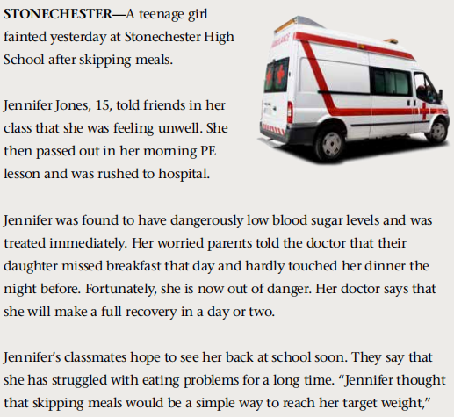
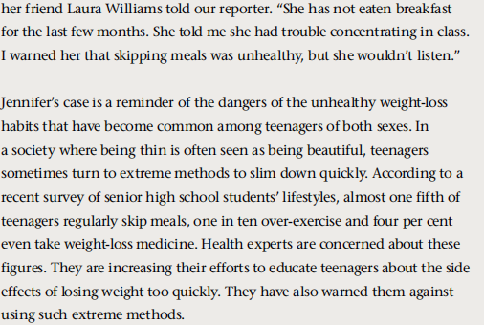
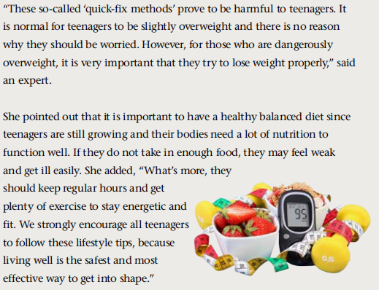
Teen faints after skipping meals
Headline
Lead
Background
or
supporting information
More detailed information about the event
Summary or suggestions

Slide 21
Discussion
What information can readers learn from an effective lead?
who
what
when
where
A teenage girl fainted yesterday at Stonechester High School
after skipping meals.
why

Slide 22
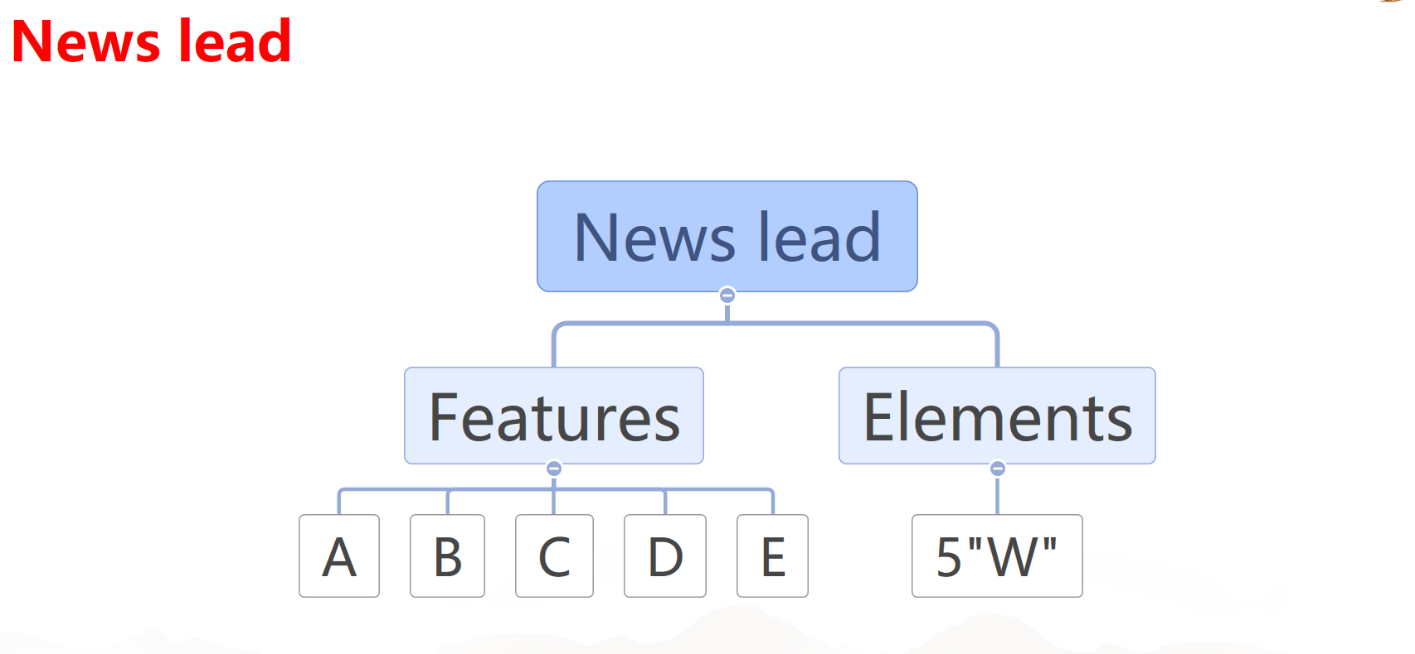
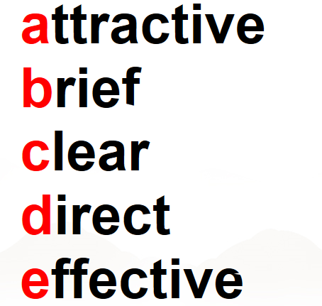
who
what
when
where
why

Slide 23
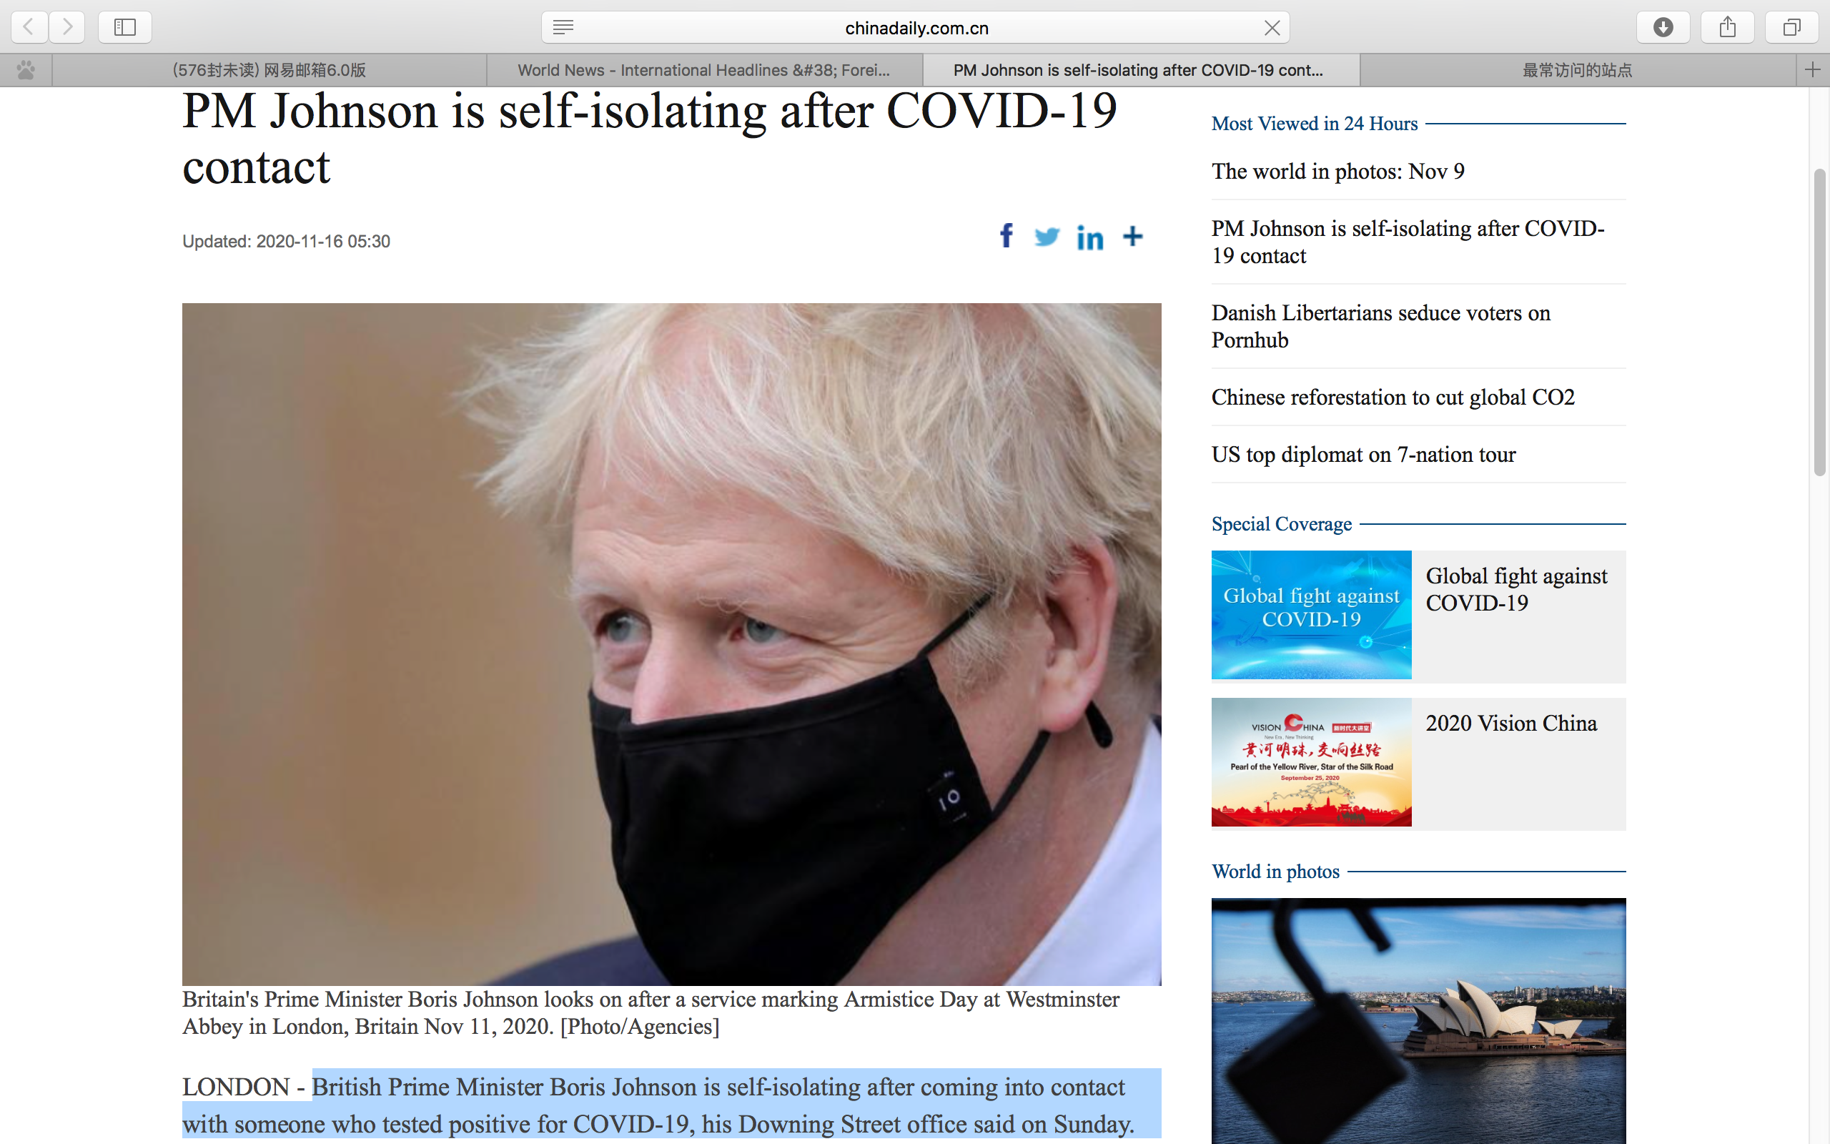
Headline
A
Lead
B

Slide 24
who
what
British Prime Minister Boris Johnson is self-isolating after coming into contact with someone who tested positive for COVID-19, his Downing Street office said on Sunday.
where
why
when

Slide 25
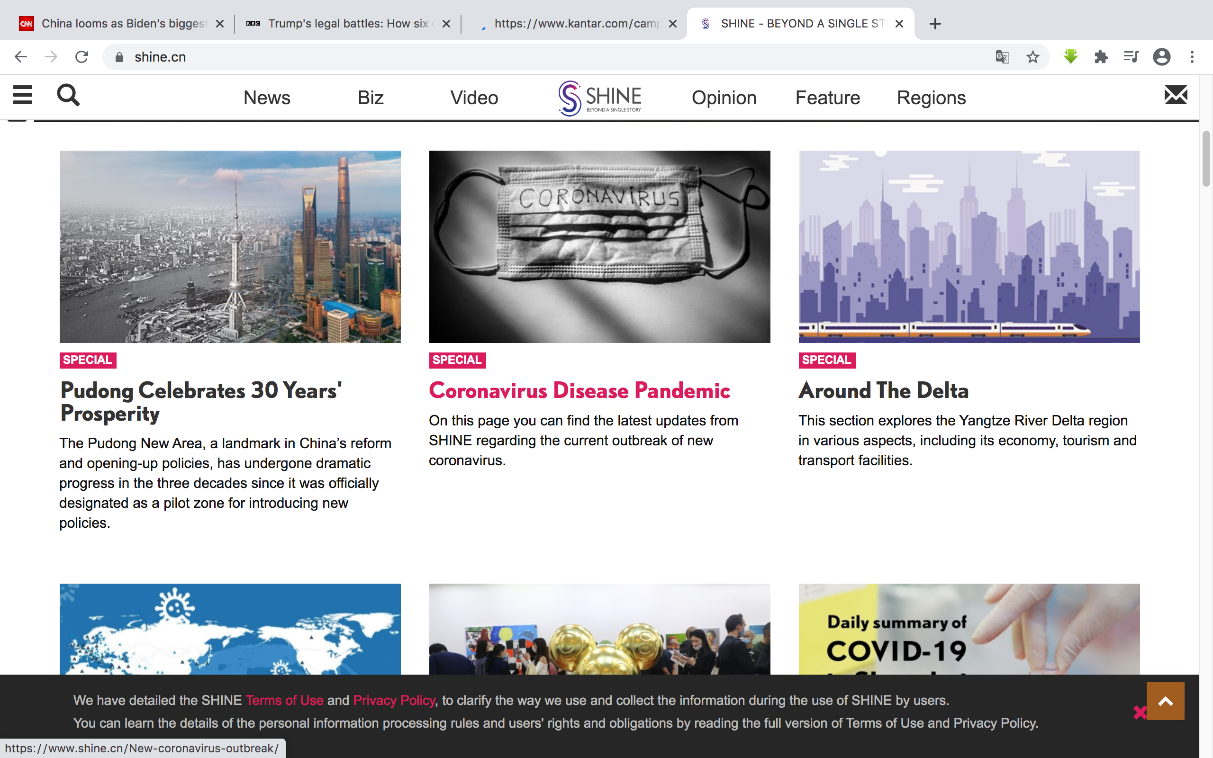
Headline
A
Lead
B

Slide 26
who
where
what
The Pudong New Area, a landmark in China’s reform
and opening-up policies, has undergone dramatic
progress in the three decades since it was officially
designated as a pilot zone for introducing new policies.
why
when

Slide 27
Consolidation
Vocabulary
B1
energetic concentrate diet get into shape
immediately prove side effect make a full recovery

Slide 28
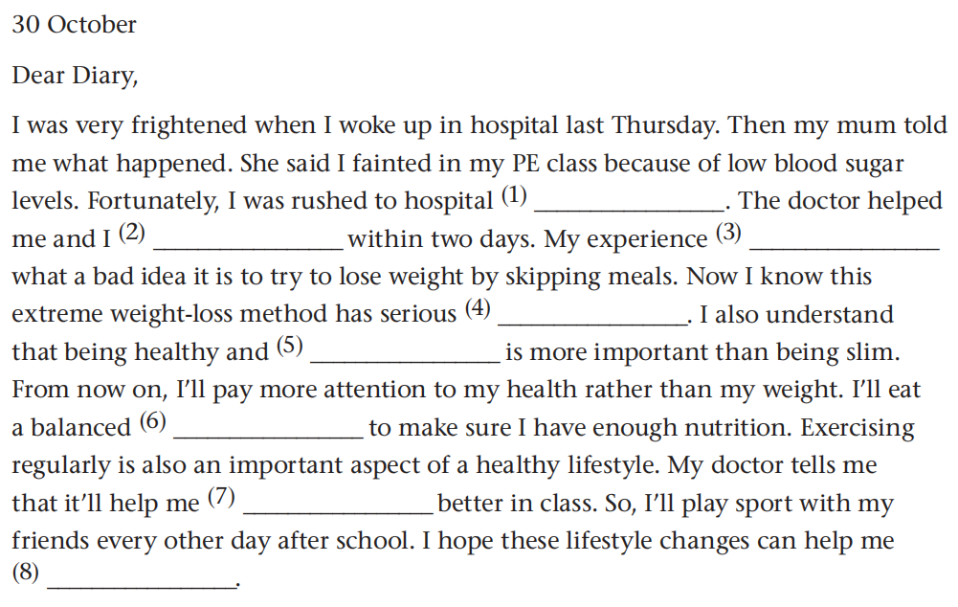
immediately
made a full recovery
proves/has proved
side effects
energetic
diet
concentrate
get into shape

Slide 29

Discussion
Do you think senior high school students should pay much attention to their weight? Why or why not?
What do you think are healthy ways of losing weight?

Slide 30
What do you think are healthy ways of losing weight?
drink more water
eat healthily
sleep well
…
Healthy ways of losing weight
exercise regularly
track progress
reduce stress

